Slide 1
Embedded Track #1
Rules of the Game

Slide 2
Production costs
Production costs is the sum of development costs plus the cost of production.
The development costs is sometimes called the non recurring costs.
Recurring Costs/Unit is the ( recurring cost)/(number of units)
Number of IOT systems we are producing maybe on the order of 10’s.
For example, if a board layout cost are $1000 dollars, then the recurring cost for the board for a unit of 10 unit is $100.00.
This does not include populating the board
This does not include the costs of the pc board or the costs of the parts
The costs of parts can be 3X the cost of a large volume producer
One of the reason low volume systems in America are made in China
Also, the hardware costs have to multiplied by 3X to a customer for sustainable environment.
This means that we could be at a 9x cost advantage to a large manufacturer
Conclusion
We cannot do things the conventional way
Many of my lost friends have not made the transition

Slide 3
Hacking won’t work either
Hacking can produce a single unit but with problems.
Lots of jumper wires
Lots of manual labor
Lots of debugging to get it to work
In essence not very reproduceable

Slide 4
What are the solutions?
We need to be able to produce 100 units.
After 100 units, capital can be raised to redesign the unit to lower costs and reduce assembly costs.
Requirements
Need to assemble 100 units in a garage.
Minimal Capital Equipment
Laptop
Voltmeter
USB Oscilloscope
Low cost soldering station
Low cost test setups
Misc. mechanical tools
Need Skilled Assemblers and Technicians
Train Software People?

Slide 5
SCADA, (PLC) is one Solution, where Raspberry PI is controller to PLC
SCADA solution requires little hardware NRE.
Low cost SCADA equipment can be purchased at
www.automationdirect.com
SCADA equipment is usually FCC and UL approved.
Low cost plc’s are price competitive
Terminal Blocks and other wiring solutions are available to handle the wiring complexity
If we are dealing with greater than 48 volts, this may be the only solution.
My farm irrigation system is based upon a SCADA type solution.
Took me several years to realize this.

Slide 6
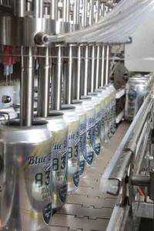
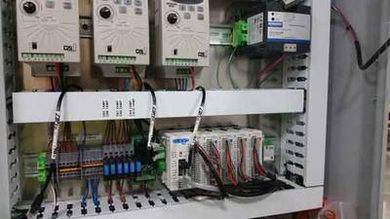
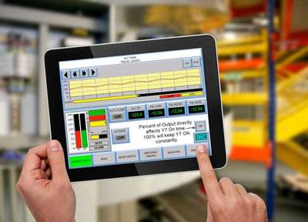
Example of a SCADA Soluton 6 reasons why automation improves beer making Application Update: A beer equipment manufacturer uses off-the-shelf automation components to build affordable equipment and systems for craft brewers. https://www.controleng.com/single-article/6-reasons-why-automation-improves-beer-making/d5a166a19d45cecd32e49a4f1c36f13c.html
$80 dollar PLC
Expansion Modules ~ $50 Each

Slide 7
Essence of Solution
WIFI
Mobile Phone
Tablets
Proprietary
SCADA Software
Serial Modbus
Low Cost
PLC’s

Slide 8
My Solution that I used on my farm
Cloud Services
Open Source
Nano Data Center
Open Source
Serial Modbus
Low Cost PLC and other devices

Slide 9
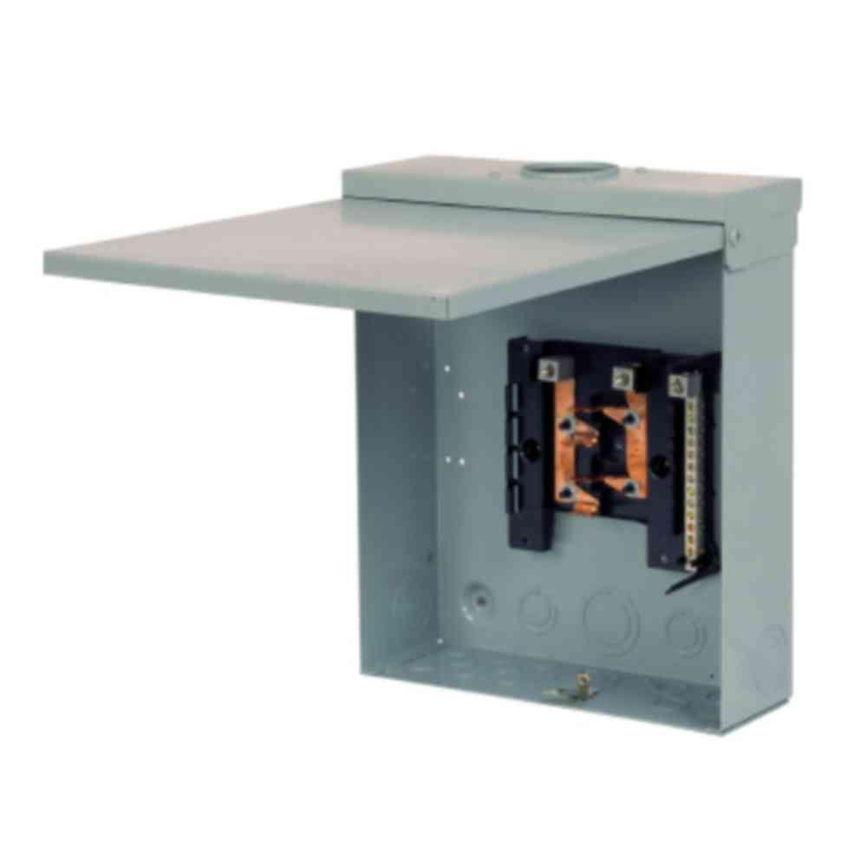
Need to make a scaled down PLC Cabinet
I start with $40
Outdoor load center
From home depot
Remove the insides

Slide 10
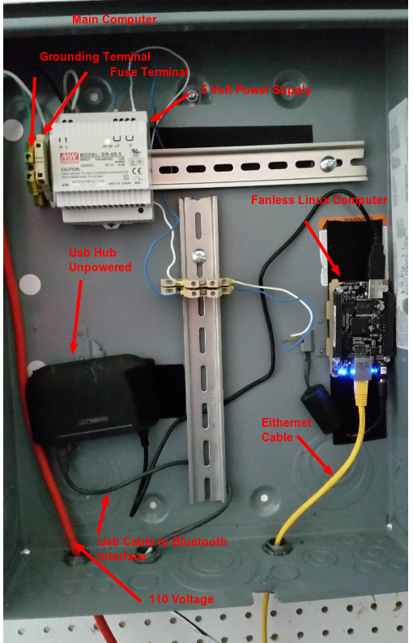
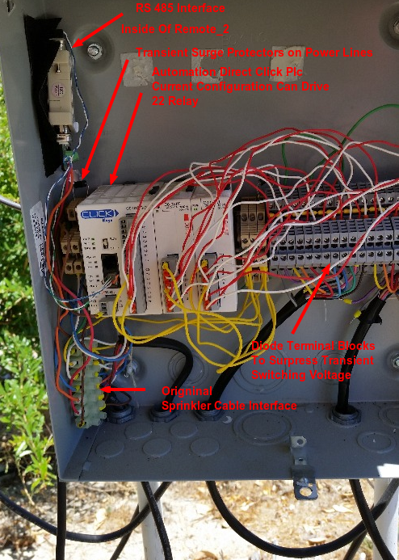
Use DIN Rails to add components
IOT Edge
Device
Field
Remote
Unit
Wiring will
Be improved
On next generation

Slide 11
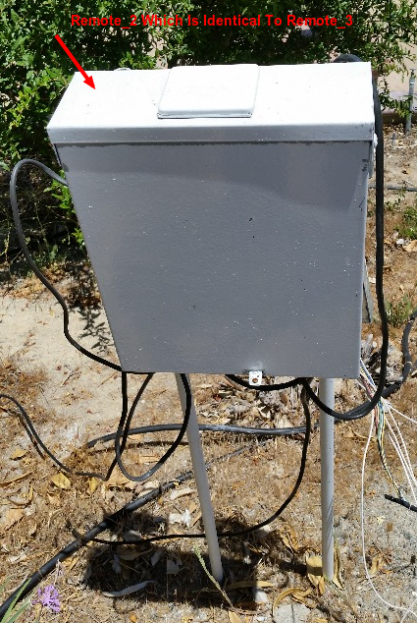
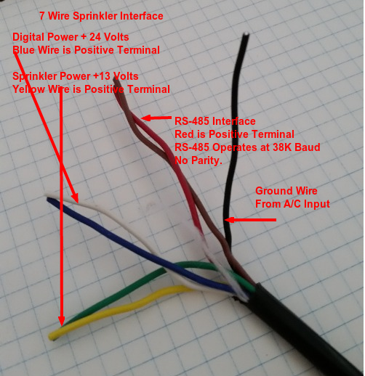
Field Remote unit deployed
Picture of Remote
Deployed
Units
Sprinkler
Wire
Provides
The power
And RS485
Links to Units

Slide 12

Remote Units serviced several years Including this

Slide 13
What about other approaches
The SCADA approach is effective for switching relays and discrete I/O.
SCADA approach has limitations.
Limited Analog Processing
Analog Capability is expensive.
PLC’s go from $120 to $200 range.
I2C and SPI devices are required.
We need to produce modules and wiring solutions which are reproduceable and reasonably cheap.

Slide 14
Rule #1 3X Markup
Do not apply the 3X Markup to hardware items that are purchased.
Many companies collapsed under that rule.
Corollary
Only develop what is required.
Use Bread Board Approach

Slide 15
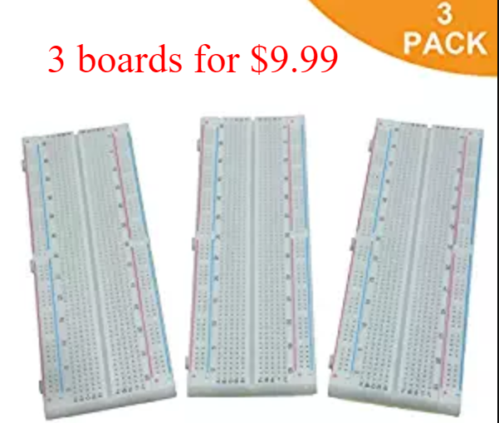
Bread Board Approach First Step: Prototype on Solderless Prototyping Boards
If the circuits will not fit on a bread board, break system out into smaller slaves

Slide 16
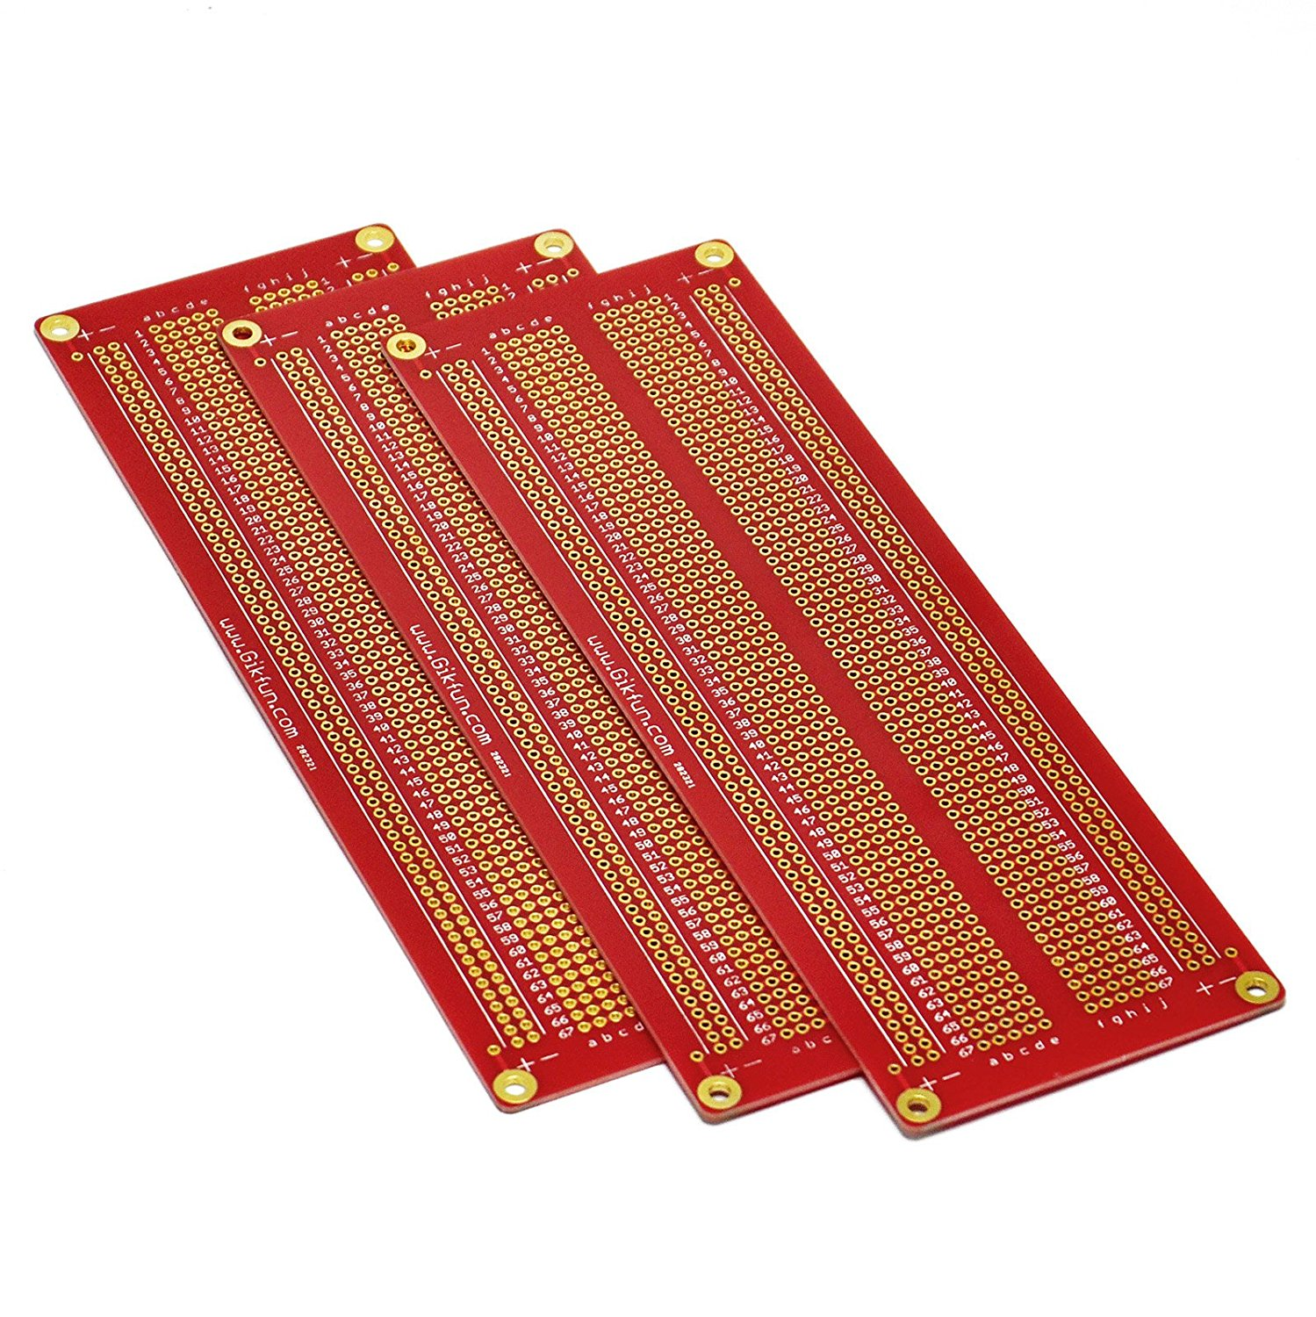
Cannot Deploy Solderless Bread Boards Will not hold connectors
3 boards for $14.00

Slide 17
PCB boards can be produced with vendor supplied tools.
ExpressPCB offers 4 layer boards 3.8”X2.5” for $30.00
Just a thought
For the Parent Maker Space
Expand the “How To Solder Class” to addition classes
How to use solderless bread boards
How to use solder bread boards
How to make PCB’s out of solder bread boards

Slide 18
Criteria for selecting processors
Processors which we use must be prototyping boards
Cannot afford to construct a custom board
Prototype processor boards must fit into prototyping boards.
Two such processors are shown in the next pages/

Slide 19
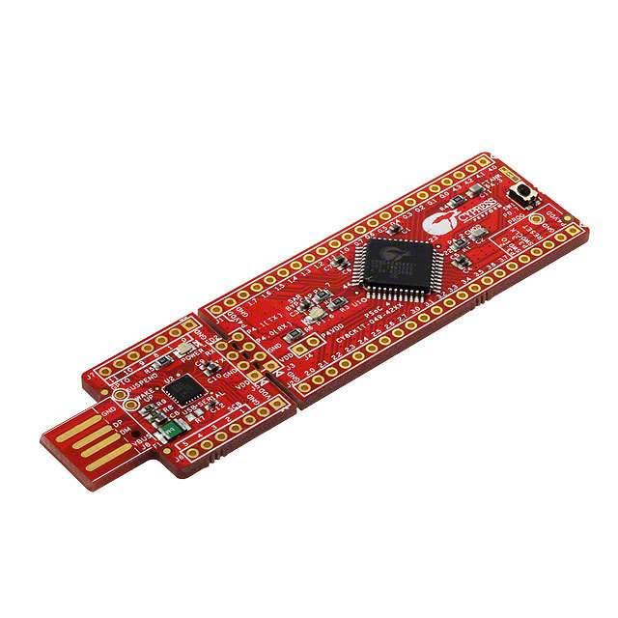
PSOC 4
The PSOC 4 is less than $5.00 from arrow ( orders over $20.00 ship overnight free)
For units over 1000 the price is $3.50 from Cypress.
Free Development tools from cypress.

Slide 20
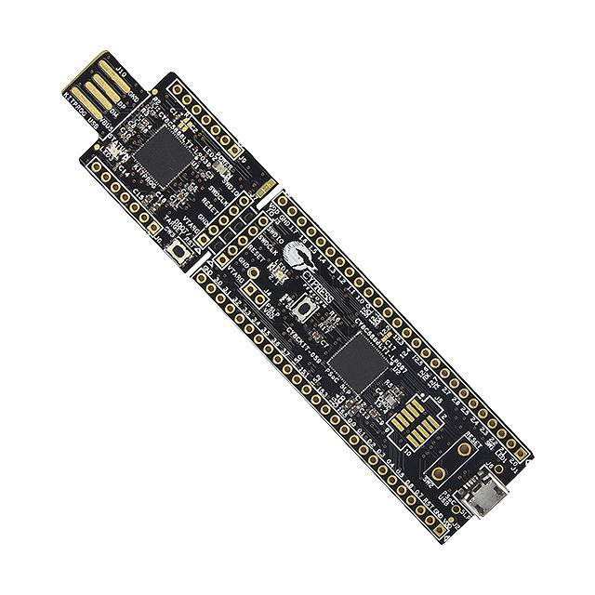
PSOC 5
This part has 4 instrumentation amplifiers and a high resolution a/d up to 18 bits. Also, the part has 4 DACS. Use this part when instrumentation situations arise.
The price of the part is $15.00 from Digi Key and $9.20 from Arrow.

Slide 21
Connections
Prototyping
Bread Board
IOT
Controller
I2c
PSOC
Module
Connectors

Slide 22
Unique Abilities of PSOC Modules
The I/O within reason can be programmed to different pin types.
It is possible to have the same board be configured to do many roles.
Makes it easier to develop a pcb for low volume applications.

Slide 23
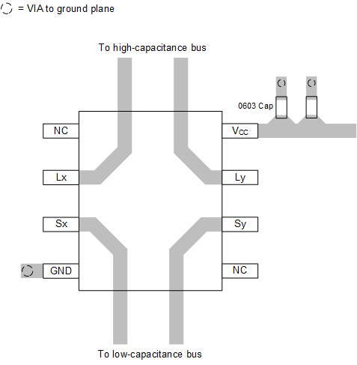
Extending Range of I2C
Allows Bus Capacitance of 400 pF on Main I²C Bus (Sx/Sy Side) and 3000 pF on Transmission Side (Lx/Ly Side)
Dual Bidirectional Unity-Voltage-Gain Buffer With No External Directional Control Required
Drives 10× Lower-Impedance Bus Wiring for Improved Noise Immunity
Multi-Drop Distribution of I²C Signals Using Low-Cost Twisted-Pair Cables
I²C Bus Operation Over 50 Meters of Twisted-Pair Wire

Slide 24
Other approaches?
Other approaches are welcome.
Solution to this problem is critical to the success of deploying complex IOT systems.

